Slide 1
Market price prediction
A Machine Learning Approach
-By pravalika

Slide 2
Introduction to the Dataset:
Background:
In the realm of market analysis and forecasting, understanding the intricate patterns within time series
data is paramount for informed decision-making. With the advent of machine learning techniques, it's
now possible to delve deeper into historical market data to predict future trends accurately. In this
context, we have at our disposal a dataset containing monthly market data spanning multiple years,
encompassing various regions, commodities, and pricing information.
Objective:
The primary objective of this project is to develop a robust time series machine learning model capable of
accurately forecasting market trends based on historical data. By leveraging advanced algorithms, we aim
to predict the quantity and prices of commodities for future months, empowering stakeholders to make
proactive decisions regarding production, procurement, pricing strategies, and resource allocation.
Description:
The dataset contains market price data with columns such as market, month, year, quantity, priceMin, priceMax, priceMod, state, city, and date.

Slide 3
Data Preprocessing:
Converted categorical variables into numerical format using Label Encoding.
Extracted month and year from the date column.
Selected relevant features and target variable.
Split the data into training and testing sets (80-20 split).

Slide 4
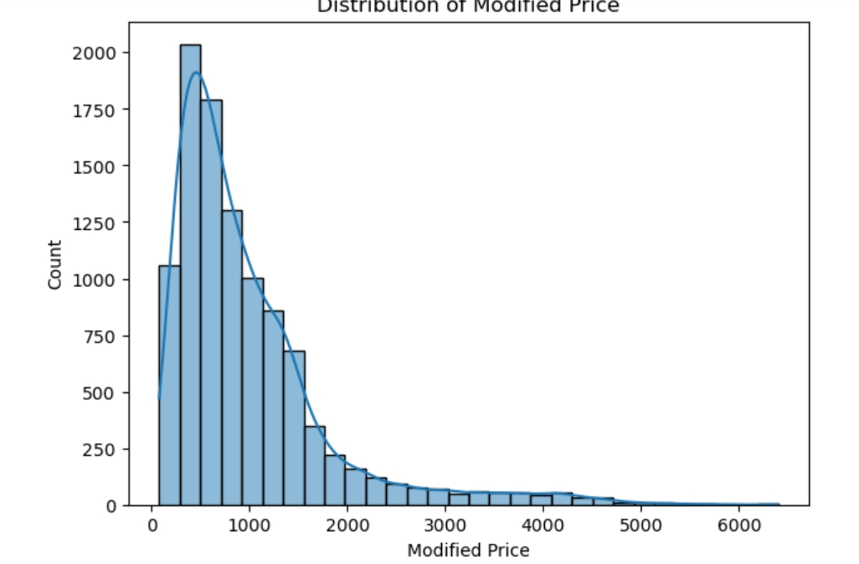
Histogram for priceMod:

Slide 5
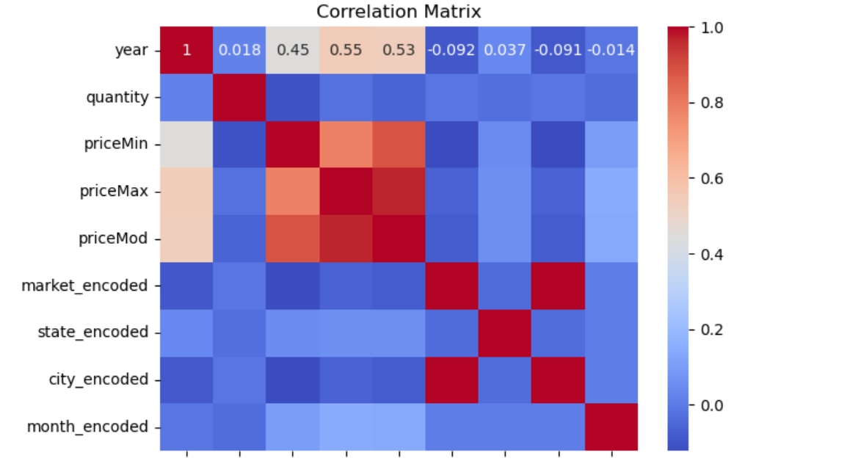
Correlation matrix:

Slide 6
Feature Engineering:
Extracted features for model training:
market, month, year, quantity, priceMin, priceMax, state, city, month_num.

Slide 7
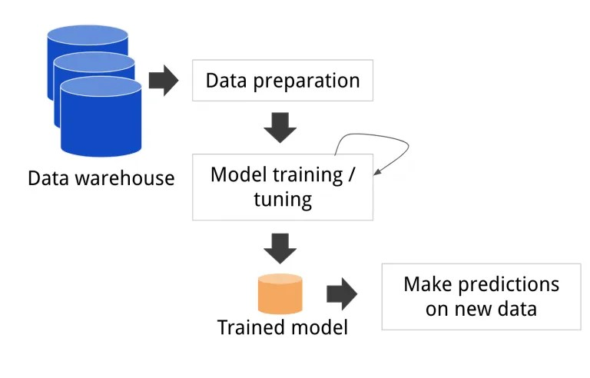
Model Training:
Trained a Random Forest Regressor model with parameters: n_estimators=100, random_state=42.

Slide 8
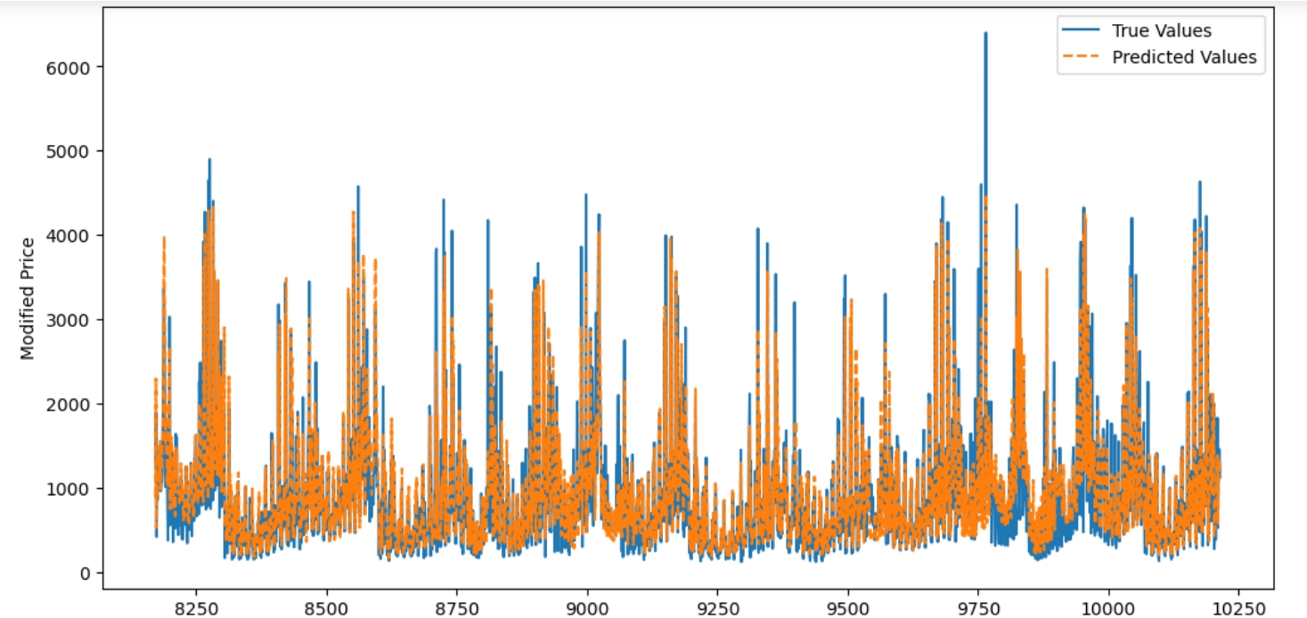
Model Evaluation:
Evaluated model performance using the test set:
Mean Absolute Error (MAE): 53.7
Mean Squared Error (MSE): 14614.20
Root Mean Squared Error (RMSE): 120.89

Slide 9
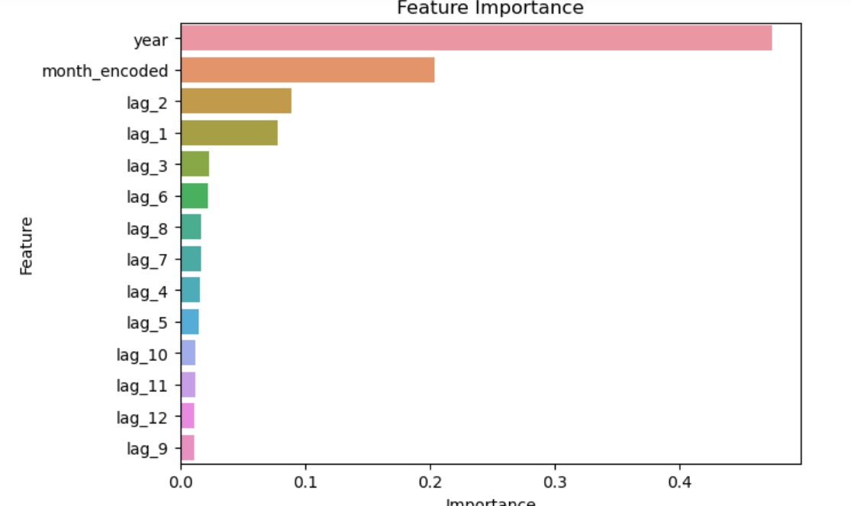
Plot for feature importance:

Slide 10
Conclusion:
The Random Forest model provided reasonable predictions for market prices.
Further tuning and feature selection could improve the model's performance.
The model can be used to predict future market prices based on historical data.

Slide 11
Thank you

